Slide 1
Personality and Values

Slide 2
Chapter Learning Objectives
After studying this chapter, you should be able to:
  Define personality, describe how it is measured, and explain the factors that determine an individual’s personality.
  Describe the Myers-Briggs Type Indicator personality framework and assess its strengths and weaknesses.
  Identify the key traits in the Big Five personality model.
  Demonstrate how the Big Five traits predict behavior at work.
  Identify other personality traits relevant to OB.
  Define values, demonstrate their importance, and contrast terminal and instrumental values.
  Compare generational differences in values, and identify the dominant values in today’s workforce.
  Identify Hofstede’s five value dimensions of national culture.

Slide 3
What is Personality?
The dynamic organization within the individual of those psychophysical systems that determine his unique adjustments to his environment. - Gordon Allport.
  The sum total of ways in which an individual reacts and interacts with others, the measurable traits a person exhibits
Measuring Personality
  Helpful in hiring decisions
  Most common method: self-reporting surveys
  Observer-ratings surveys provide an independent assessment of personality – often better predictors

Slide 4
Personality Determinants
Heredity
  Factors determined at conception: physical stature, facial attractiveness, gender, temperament, muscle composition and reflexes, energy level, and bio-rhythms
  This “Heredity Approach” argues that genes are the source of personality
  Twin studies: raised apart but very similar personalities
  Parents don’t add much to personality development
  There is some personality change over long time periods

Slide 5

Personality Traits
Enduring characteristics that describe an individual’s behavior
  The more consistent the characteristic and the more frequently it occurs in diverse situations, the more important the trait.
Two dominant frameworks used to describe personality:
  Myers-Briggs Type Indicator (MBTI®)
  Big Five Model

Slide 6
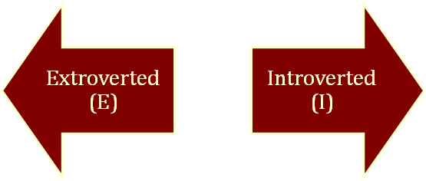
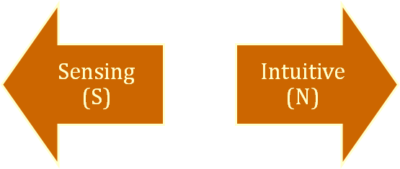
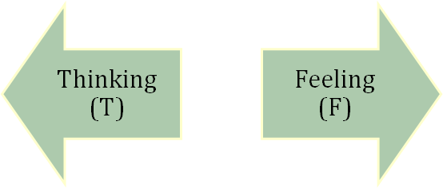
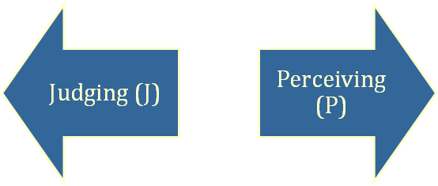
The Myers-Briggs Type Indicator
Most widely used instrument in the world.
Participants are classified on four axes to determine one of 16 possible personality types, such as ENTJ.
Sociable and Assertive
Quiet and
Shy
Practical and
Orderly
Unconscious
Processes
Use Reason
and Logic
Uses Values & Emotions
Want Order
& Structure
Flexible and Spontaneous
Notes:
The terms Introvert and Extravert (normally spelled 'extrovert' outside of the Myers-Briggs context) are referred to as attitudes and show how a person orients and receives their energy. In the extraverted attitude the energy flow is outward, and the preferred focus is on other people and things, whereas in the introverted attitude the energy flow is inward, and the preferred focus is on one's own thoughts, ideas and impressions.
Sensing and Intuition are the perceiving functions. These are the nonrational functions, as a person does not necessarily have control over receiving data, but only how to process it once they have it. Sensing people tend to focus on the present and on concrete information gained from their senses. Sensing prefers to receive data primarily from the five senses. Intuition tend to focus on the future, with a view toward patterns and possibilities. These people prefer to receive data from the subconscious, or seeing relationships via insights.
Thinking and Feeling are the decision making calculus functions. They both strive to make rational choices, using the data received from their perceiving functions, above. Thinking tend to base their decisions on logic "true or false, if-then" connections and on objective analysis of cause and effect. Feeling tend to base their decisions primarily on values and on subjective evaluation of person centered concerns. Feelings use "more or less, better-worse" evaluations. It could be said that thinkers decide with their heads, while feelers decide with their hearts. When Thinking or Feeling is extraverted, decisions tend to rely on external sources and the generally accepted rules and procedures. When introverted, Thinking and Feeling decisions tend to be subjective, relying on internally generated ideas for logical organization and evaluation.
Judging and Perceiving reveals the specific attitudes of the functions. J or P records which of the strongest of the judging functions or perceiving functions is outwardly displayed. People who prefer judging tend to like a planned and organized approach to life and prefer to have things settled. People who prefer Perceiving tend to like a flexible and spontaneous approach to life and prefer to keep their options open. (The terminology may be misleading for some—the term "Judging" does not imply "judgmental", and "Perceiving" does not imply "perceptive".)
In J-types, the preferred judging function (T or F) is extraverted (displayed in the outer world). J-types tend to prefer a step-by-step (left brain: parts to whole) approach to life, relying on external rules and procedures, and preferring quick closure. The preferred perceiving function (S or N) is introverted.
On the other hand, in P-types the preferred perceiving function is extraverted, and the preferred judging function is introverted. This can result in a "bouncing around" approach to life (right brain: whole to parts), relying on subjective judgments, and a desire to leave all options open.
For introverts, it is the auxiliary function, not the dominant function, that this letter refers to. MBTI INTP, for example, has a dominant Judging function, introverted Thinking (Ti), but it is actually a Perceiving type in MBTI because the strongest Perceiving function is extraverted iNtuition (Ne). (Socionics, a personality theory similar to MBTI, follows opposite notation for introverts; the J/P designation in this theory refers to the dominant function for all types.)

Slide 7
The Types and Their Uses
Each of the sixteen possible combinations has a name, for instance:
  Visionaries (INTJ) – original, stubborn, and driven.
  Organizers (ESTJ) – realistic, logical, analytical, and businesslike.
  Conceptualizer (ENTP) – entrepreneurial, innovative, individualistic, and resourceful.
Research results on validity mixed.
  MBTI® is a good tool for self-awareness and counseling.
  Should not be used as a selection test for job candidates.

Slide 8
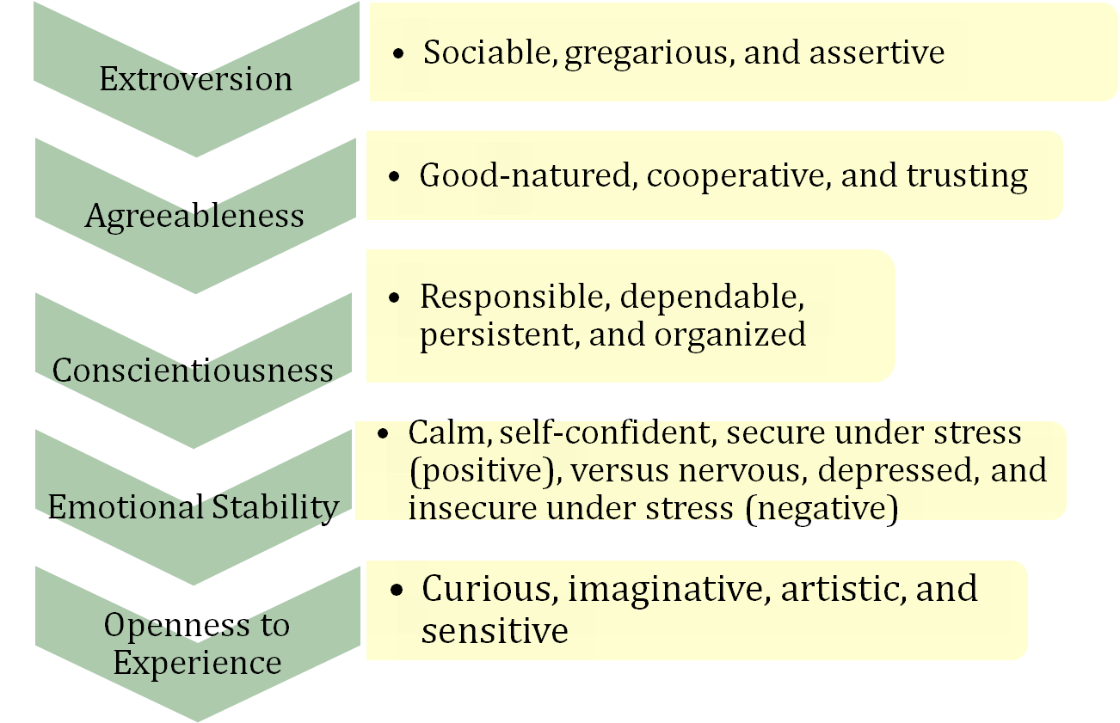
The Big Five Model of Personality Dimensions

Slide 9
Sample Extraversion Items
I am the life of the party.
I don't mind being the center of attention.
I feel comfortable around people.
I start conversations.
I talk to a lot of different people at parties.
I am quiet around strangers. (reversed)
I don't like to draw attention to myself. (reversed)
I don't talk a lot. (reversed)
I have little to say. (reversed)
I keep in the background. (reversed)

Slide 10
Sample Agreeableness Items
I am interested in people.
I feel others’ emotions.
I have a soft heart.
I make people feel at ease.
I sympathize with others’ feelings.
I take time out for others.
I am not interested in other people’s problems. (reversed)
I am not really interested in others. (reversed)
I feel little concern for others. (reversed)
I insult people. (reversed)

Slide 11
Sample Conscientiousness Items
I am always prepared.
I am exacting in my work.
I follow a schedule.
I get chores done right away.
I like order.
I pay attention to details.
I leave my belongings around. (reversed)
I make a mess of things. (reversed)
I often forget to put things back in their proper place. (reversed)
I shirk my duties. (reversed)

Slide 12
Sample Neuroticism Items
I am easily disturbed.
I change my mood a lot.
I get irritated easily.
I get stressed out easily.
I get upset easily.
I have frequent mood swings.
I often feel blue.
I worry about things.
I am relaxed most of the time. (reversed)
I seldom feel blue. (reversed)

Slide 13
Sample Openness Items
I am full of ideas.
I am quick to understand things.
I have a rich vocabulary.
I have a vivid imagination.
I have excellent ideas.
I spend time reflecting on things.
I use difficult words.
I am not interested in abstract ideas. (reversed)
I do not have a good imagination. (reversed)
I have difficulty understanding abstract ideas. (reversed)

Slide 14
How Do the Big Five Traits Predict Behavior?
Research has shown this to be a better framework.
Certain traits have been shown to strongly relate to higher job performance:
  Highly conscientious people develop more job knowledge, exert greater effort, and have better performance.
  Other Big Five Traits also have implications for work.
    Emotional stability is related to job satisfaction.
    Extroverts tend to be happier in their jobs and have good social skills.
    Open people are more creative and can be good leaders.
    Agreeable people are good in social settings.
See E X H I B I T 4–2

Slide 15

Other Personality Traits Relevant to OB
Core Self-Evaluation
  The degree to which people like or dislike themselves
  Positive self-evaluation leads to higher job performance
Machiavellianism
  A pragmatic, emotionally distant power-player who believes that ends justify the means.
  High Machs are manipulative, win more often, and persuade more than they are persuaded. Flourish when:
    Have direct interaction
    Work with minimal rules and regulations
    Emotions distract others
Narcissism
  An arrogant, entitled, self-important person who needs excessive admiration.
  Less effective in their jobs.

Slide 16

More Relevant Personality Traits
Self-Monitoring
  The ability to adjust behavior to meet external, situational factors.
  High monitors conform more and are more likely to become leaders.
Risk Taking
  The willingness to take chances.
  May be best to align propensities with job requirements.
  Risk takers make faster decisions with less information.
© 2009 Prentice-Hall Inc. All rights reserved.
4-<number>

Slide 17
Even More Relevant Personality Traits
Type A Personality
  Aggressively involved in a chronic, incessant struggle to achieve more in less time
    Impatient: always moving, walking, and eating rapidly
    Strive to think or do two or more things at once
    Cannot cope with leisure time
    Obsessed with achievement numbers
  Prized in North America but quality of the work is low
  Type B people are the complete opposite
Proactive Personality
  Identifies opportunities, shows initiative, takes action, and perseveres to completion
  Creates positive change in the environment
© 2009 Prentice-Hall Inc. All rights reserved.
4-<number>

Slide 18

Values
Basic convictions on how to conduct yourself or how to live your life that is personally or socially preferable – “How To” live life properly.
Attributes of Values:
  Content Attribute – that the mode of conduct or end-state is important
  Intensity Attribute – just how important that content is.
Value System
  A person’s values rank ordered by intensity
  Tends to be relatively constant and consistent
© 2009 Prentice-Hall Inc. All rights reserved.
4-<number>

Slide 19

Importance of Values
Provide understanding of the attitudes, motivation, and behaviors
Influence our perception of the world around us
Represent interpretations of “right” and “wrong”
Imply that some behaviors or outcomes are preferred over others
© 2009 Prentice-Hall Inc. All rights reserved.
4-<number>

Slide 20
Classifying Values – Rokeach Value Survey
Terminal Values
  Desirable end-states of existence; the goals that a person would like to achieve during his or her lifetime
Instrumental Values
  Preferable modes of behavior or means of achieving one’s terminal values
People in same occupations or categories tend to hold similar values
  But values vary between groups
  Value differences make it difficult for groups to negotiate and may create conflict
© 2009 Prentice-Hall Inc. All rights reserved.
4-<number>

Slide 21
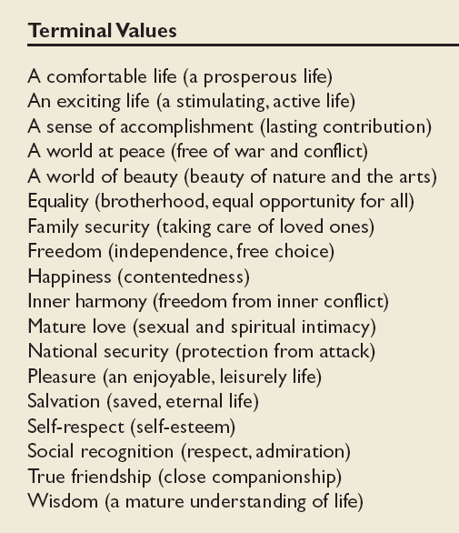
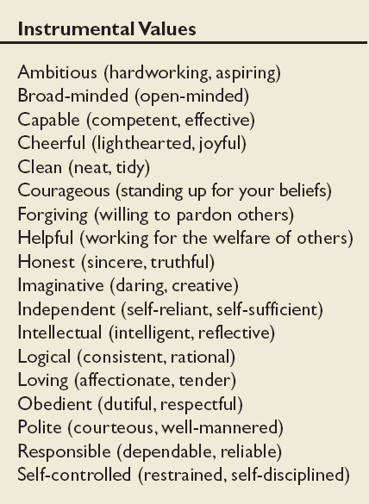
Values in the Rokeach Survey
E X H I B I T 4–3
© 2009 Prentice-Hall Inc. All rights reserved.
4-<number>

Slide 22
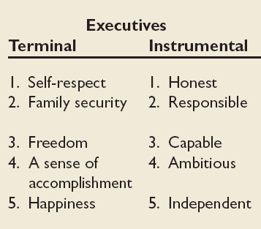
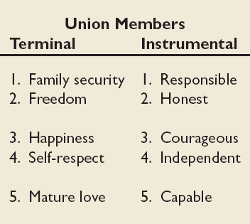
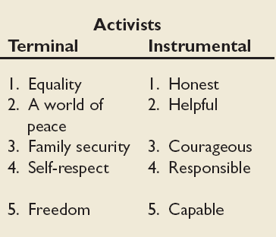

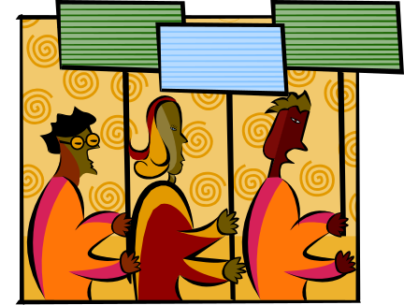
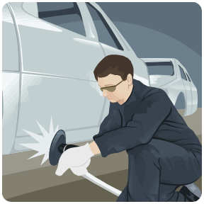
Value Differences Between Groups
Source: Based on W. C. Frederick and J. Weber, “The Values of Corporate Managers and Their Critics: An Empirical Description and Normative Implications,” in W. C. Frederick and L. E. Preston (eds.) Business Ethics: Research Issues and Empirical Studies (Greenwich, CT: JAI Press, 1990), pp. 123–44.
E X H I B I T 4–4
© 2009 Prentice-Hall Inc. All rights reserved.
4-<number>

Slide 23
Generational Values
Cohort | Entered Workforce | Approximate Current Age | Dominant Work Values
Veterans | 1950-1964 | 65+ | Hard working, conservative, conforming; loyalty to the organization
Boomers | 1965-1985 | 40-60s | Success, achievement, ambition, dislike of authority; loyalty to career
Xers | 1985-2000 | 20-40s | Work/life balance, team-oriented, dislike of rules; loyalty to relationships
Nexters | 2000-Present | Under 30 | Confident, financial success, self-reliant but team-oriented; loyalty to both self and relationships
E X H I B I T 4–5
© 2009 Prentice-Hall Inc. All rights reserved.
4-<number>

Slide 24
Linking Personality and Values to the Workplace
Managers are less interested in someone’s ability to do a specific job than in that person’s flexibility.
Person-Job Fit:
  John Holland’s Personality-Job Fit Theory
    Six personality types
    Vocational Preference Inventory (VPI)
  Key Points of the Model:
    There appear to be intrinsic differences in personality between people
    There are different types of jobs
    People in jobs congruent with their personality should be more satisfied and have lower turnover
© 2009 Prentice-Hall Inc. All rights reserved.
4-<number>

Slide 25
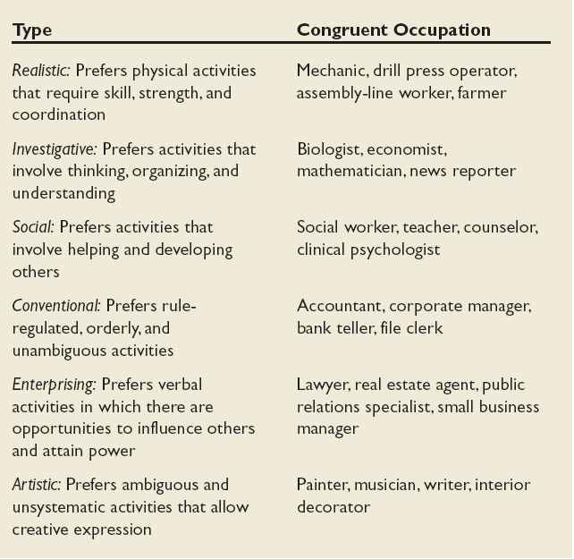
Holland’s Personality Typology & Occupations
E X H I B I T 4–7
© 2009 Prentice-Hall Inc. All rights reserved.
4-<number>

Slide 26
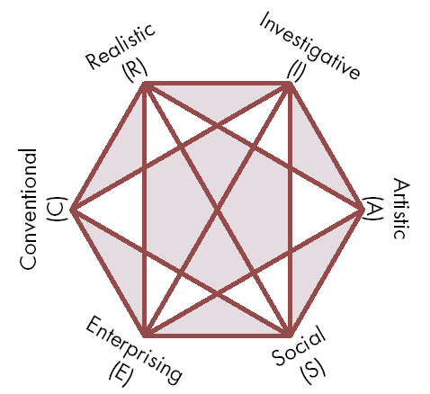
Relationships Among Personality Types
The closer the occupational fields, the more compatible.
The further apart the fields, the more dissimilar.
Need to match personality type with occupation.
Source: Reprinted by special permission of the publisher, Psychological Assessment Resources, Inc., from Making Vocational Choices, copyright 1973, 1985, 1992 by Psychological Assessment Resources, Inc. All rights reserved.
E X H I B I T 4–8
© 2009 Prentice-Hall Inc. All rights reserved.
4-<number>

Slide 27
Still Linking Personality to the Workplace
In addition to matching the individual’s personality to the job, managers are also concerned with:
Person-Organization Fit:
  The employee’s personality must fit with the organizational culture.
  People are attracted to organizations that match their values.
  Those who match are most likely to be selected.
  Mismatches will result in turnover.
  Can use the Big Five personality types to match to the organizational culture.
© 2009 Prentice-Hall Inc. All rights reserved.
4-<number>

Slide 28
Summary and Managerial Implications
Personality
  Screen for the Big Five trait of conscientiousness
  Take into account the situational factors as well
  MBTI® can help with training and development
Values
  Often explain attitudes, behaviors, and perceptions
  Higher performance and satisfaction achieved when the individual’s values match those of the organization.
© 2009 Prentice-Hall Inc. All rights reserved.
4-<number>

